Slide 1


Slide 2
What Is Aperio?
Water Quality Sensor
Turbidity, salinity, contaminants, etc.
“Purity Score” algorithm
Accessible online
Alerts (Readout, SMS, app, email)

Slide 3
Design Goals
Cost Effective Production
Consumer Marketability
Device Connectivity

Slide 4
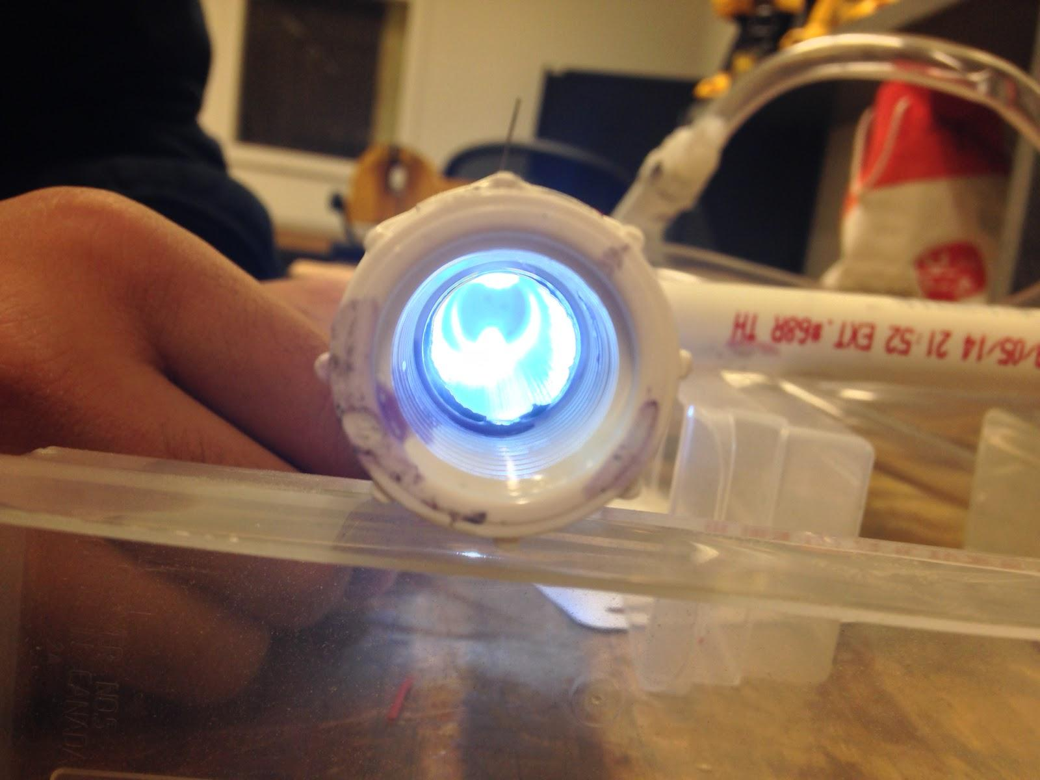
Current Prototype

Slide 5
Target Audience
Young Adults
Parents
Immediately accessible network
Environmental awareness
Crowdfunding
Technology and connectivity
Health concerns
Young children
Home appliances

Slide 6
Acquiring Data
Social networks
Website, online beta
Email list
Questionnaire
Gauging interest

Slide 7
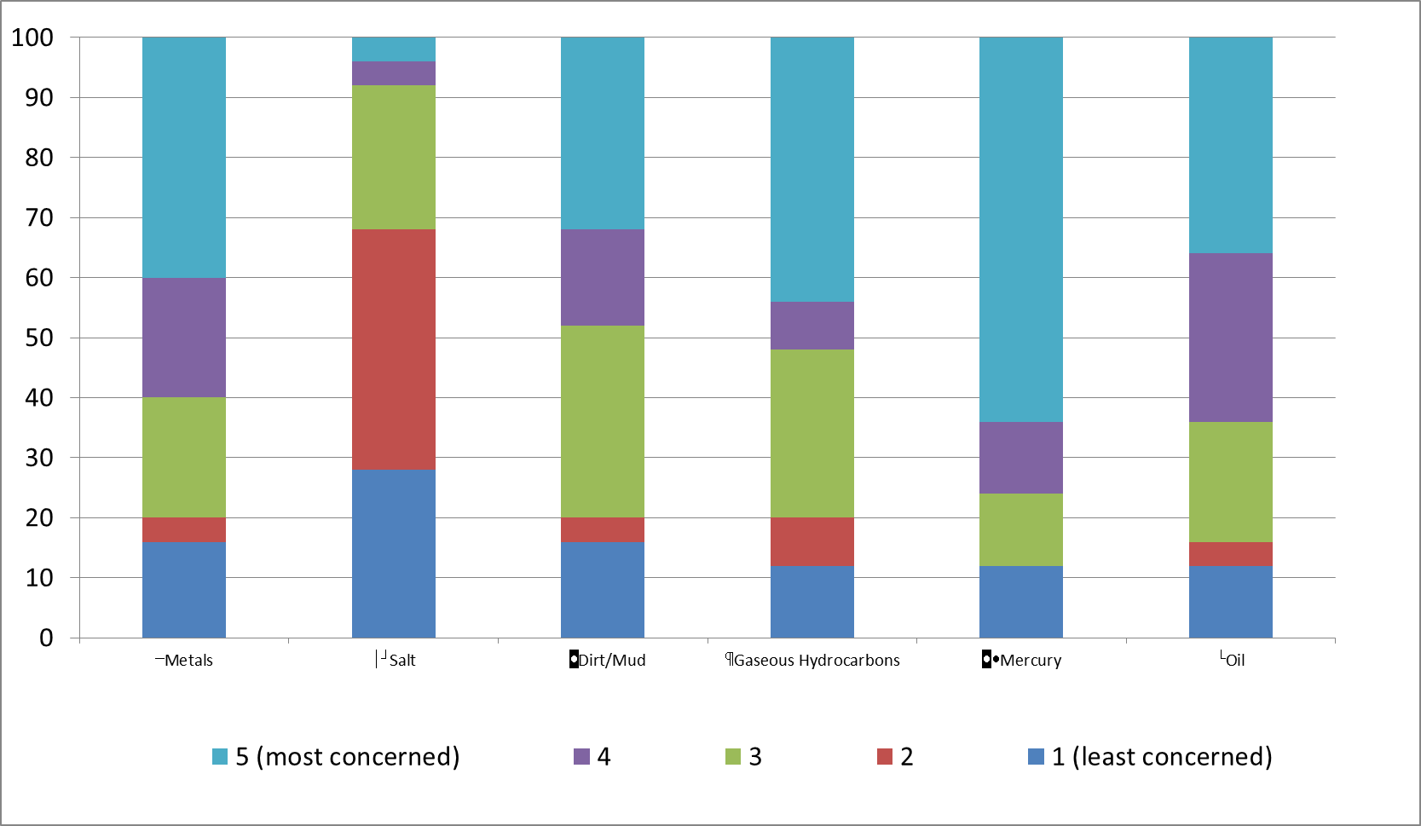
Responses

Slide 8
More Feedback
Add-on solution instead of full faucet
Aperio vs. filter
Confidence in city water

Slide 9
Application of Data
Aperio Micro
Sensor Priority List

Slide 10
Visit us at aperiofaucet.net github.com/mdiamond14/Aperio/ kickstarter.com/projects/545246334/844326656?token=9b80a16d

